Slide 1


CREDIT CARD DEFAULT PREDICTION
BY - NISHIKA PATEL
- VAIBHAV JOSHI
DATE: 04/072023

Slide 2





Project Details
Dataset
Overview
Conclusion
Credit
Card
Default
Prediction
Model
comparison
EDA
Predictive
Modeling

Slide 3

Overview and Goal
Overview
Financial institutions like banks play a big part in offering financial services. Bank must use caution when investing in clients to preserve integrity and prevent financial loss. The bank must consider potential clients before extending loans to debtors. Therefore, the objective is to forecast the likelihood of credit default based on the traits of credit card owners and their payment history.
Goal
The model we developed here will make use of all relevant variables to forecast client data in order to identify defaulters and non-defaulters for the upcoming month. The objective is to determine if the consumers can pay their credit balance for the following month. Find a few potential consumers who can pay off the bank's credit debt. to ascertain whether their clients could timely pay using a credit card. Failure to make a loan or credit card payment, including interest and principle, is known as default.

Slide 4
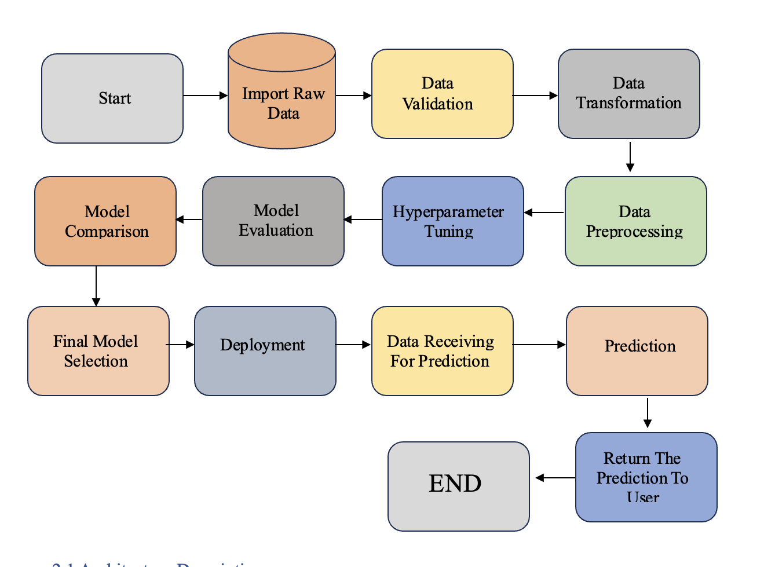
Approach Overview

Slide 5
Project Details
Dataset
Overview
Conclusion
Credit
Card
Default
Prediction
Model
comparison
EDA
Predictive
Modeling

Slide 6
Data Acquisition
The Data View
Real credit card data Comprehensive and complete 30,000 customers Usage of 6 months Age from 20-79 Demographic factors No credit score or credit history
Dataset Source
Credit Card Client Default Payments duration 6 months Original Source: UCI Machine Learning Repository. Source: Public dataset from Kaggle.

Slide 7
Dependent & Independent Variable
Dependent Variable
Default Payment Next Month
Independent Variable
Customer ID ﻿Credit limit ﻿Gender ﻿Age ﻿Marital status ﻿Level of education ﻿History of their past payments made (April to September) ﻿Amount of bill statement (1 to 6) ﻿Amount of previous payment (1 to 6)

Slide 8
Project Details
Dataset
Overview
Conclusion
Credit
Card
Default
Prediction
Model
comparison
EDA
Predictive
Modeling

Slide 9
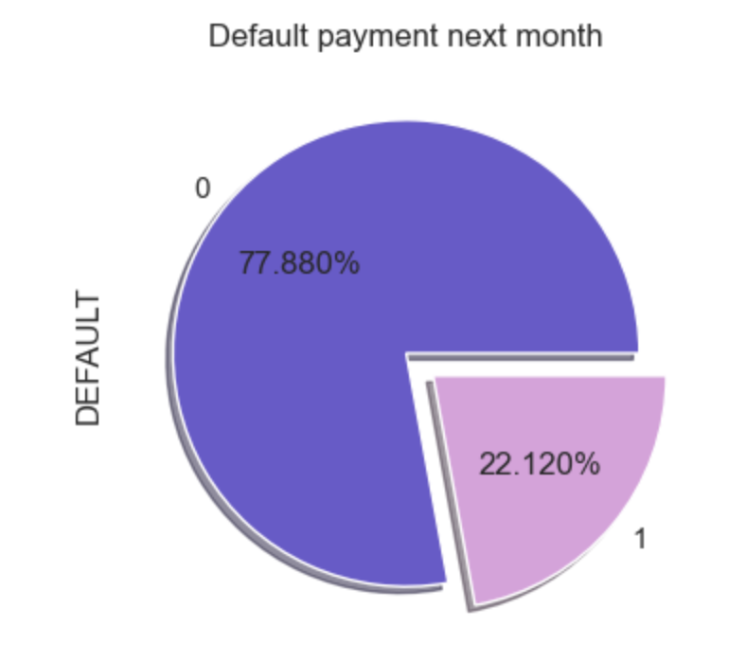
Dependent & Independent Variable
Conclusion
Pie Chart shows total number of records for defaulters and non-defaulters. If they would do payment or not (yes=1 no=0) for next month. 22.120% - default 77.880% - non-default
ScreenShot Taken while Evaluation Process.

Slide 10
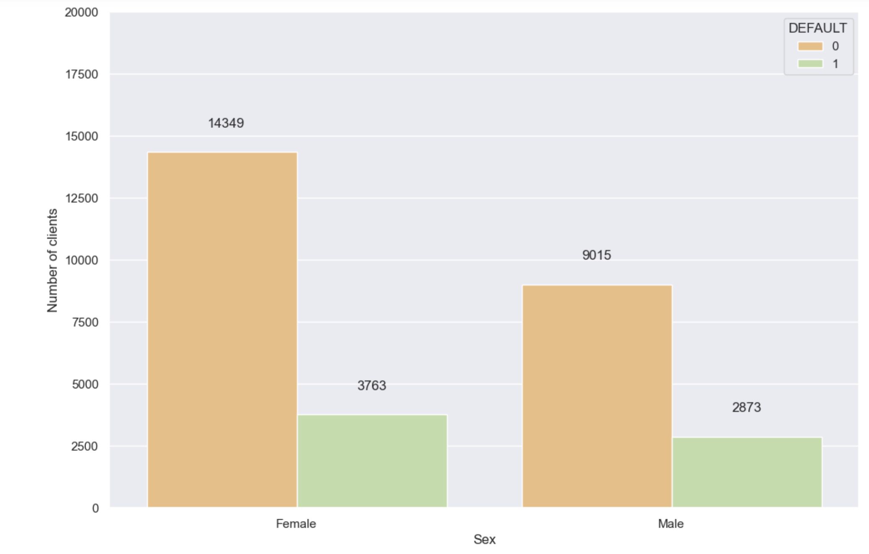
Based on Gender Variable
Conclusion
Bar Chart shows total number of records for defaulters and non-defaulters based on Gender Variable. Here we cleary notice that Approx 2873 of males and 3763 of females have payment default.
ScreenShot Taken while Evaluation Process.

Slide 11
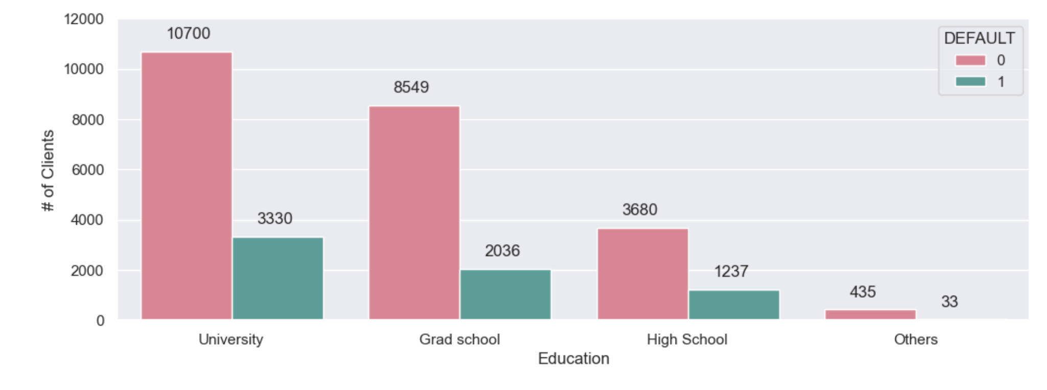
Based on Education Variable
Conclusion
Bar Chart shows total number of records for defaulters and non-defaulters based on Education Variable. Here we clearly notice most of credit card users have higher studies education. Higher education level, lower default risk.
ScreenShot Taken while Evaluation Process.

Slide 12
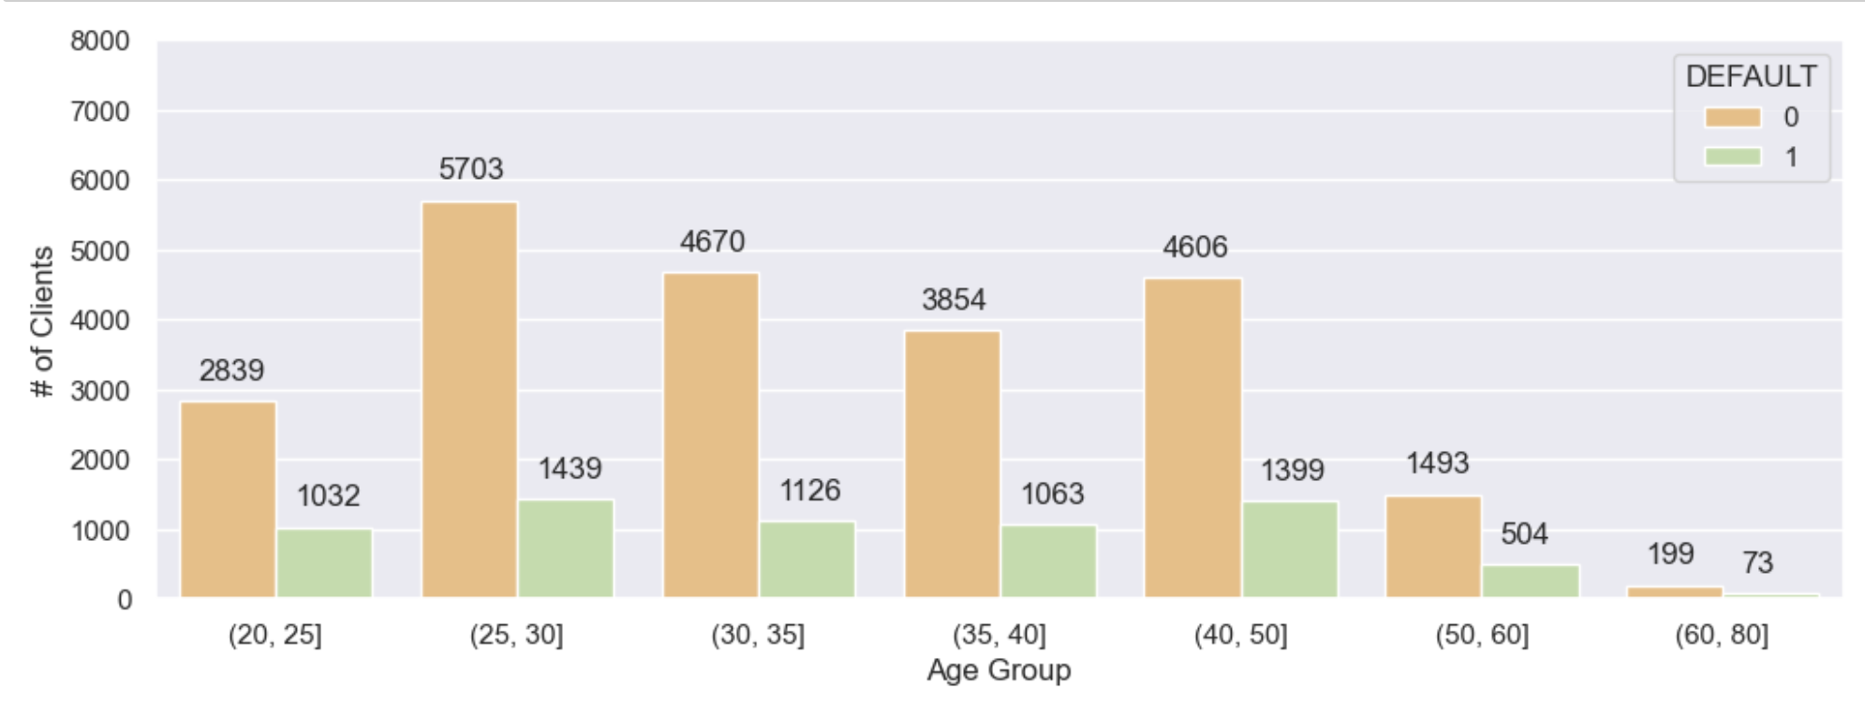
Based on Age Variable
Conclusion
Bar Chart shows total number of records for defaulters and non-defaulters based on Age group. Here we clearly notice that most of the credit card users are 25 to 30 30-50: Lowest risk < 30 >50: Risk increases
ScreenShot Taken while Evaluation Process.

Slide 13
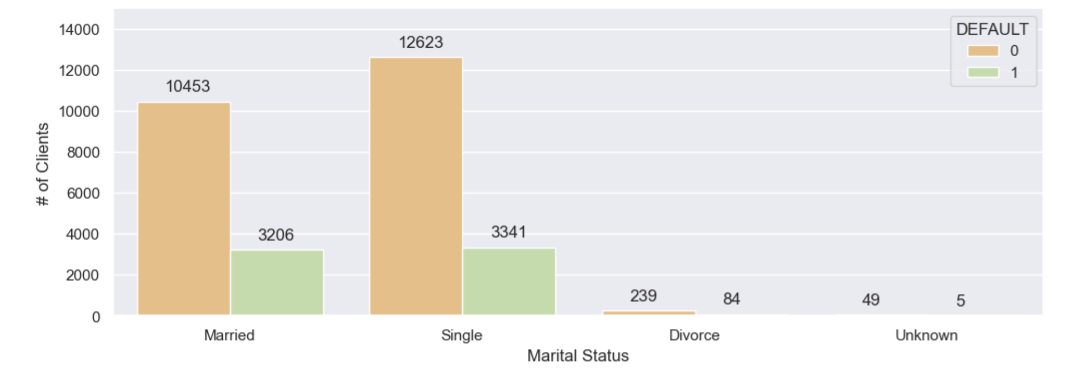
Based on Marital Status Variable
Conclusion
Bar Chart shows total number of records for defaulters and non-defaulters based on Marittal Status. No significant correlations of default risk and marital status
ScreenShot Taken while Evaluation Process.

Slide 14
Project Details
Dataset
Overview
Conclusion
Credit
Card
Default
Prediction
Model
comparison
EDA
Predictive
Modeling

Slide 15
Model Overview
Define Problem: | Supervised learning
Tools Used: | Scikit learn library Imblearn Pickle XGBoost
Models Applied: | Logistic Regression Random Forest Decision Tree XGBoost
Imbalanced Classes: | 78% non-default vs. 22% default
Hyperparameter Tuning | Grid Search Randomized Search

Slide 16
Project Details
Dataset
Overview
Conclusion
Credit
Card
Default
Prediction
Model
comparison
EDA
Predictive
Modeling

Slide 17
Model Comparison
Model | Accuracy | Precision | Recall | F1 Score | AUC_ROC
Logistic Regression without tuning | 77.777778 | 0.000000 | 0.0000 | 0.000000 | 0.500000
Logistic Regression with tuning | 77.677778 | 0.153846 | 0.0010 | 0.001987 | 0.499714
Random Forest without tuning | 78.211111 | 0.533333 | 0.1560 | 0.241393 | 0.697442
Random Forest with tuning | 78.588889 | 0.612308 | 0.0995 | 0.171183 | 0.702392
Decision Tree without tuning | 75.277778 | 0.390883 | 0.2015 | 0.265919 | 0.555893
Decision Tree with tuning | 74.188889 | 0.379926 | 0.2555 | 0.305531 | 0.637417
xgboost without Tuning | 76.411111 | 0.413986 | 0.14800 | 0.218048 | 0.619724

Slide 18
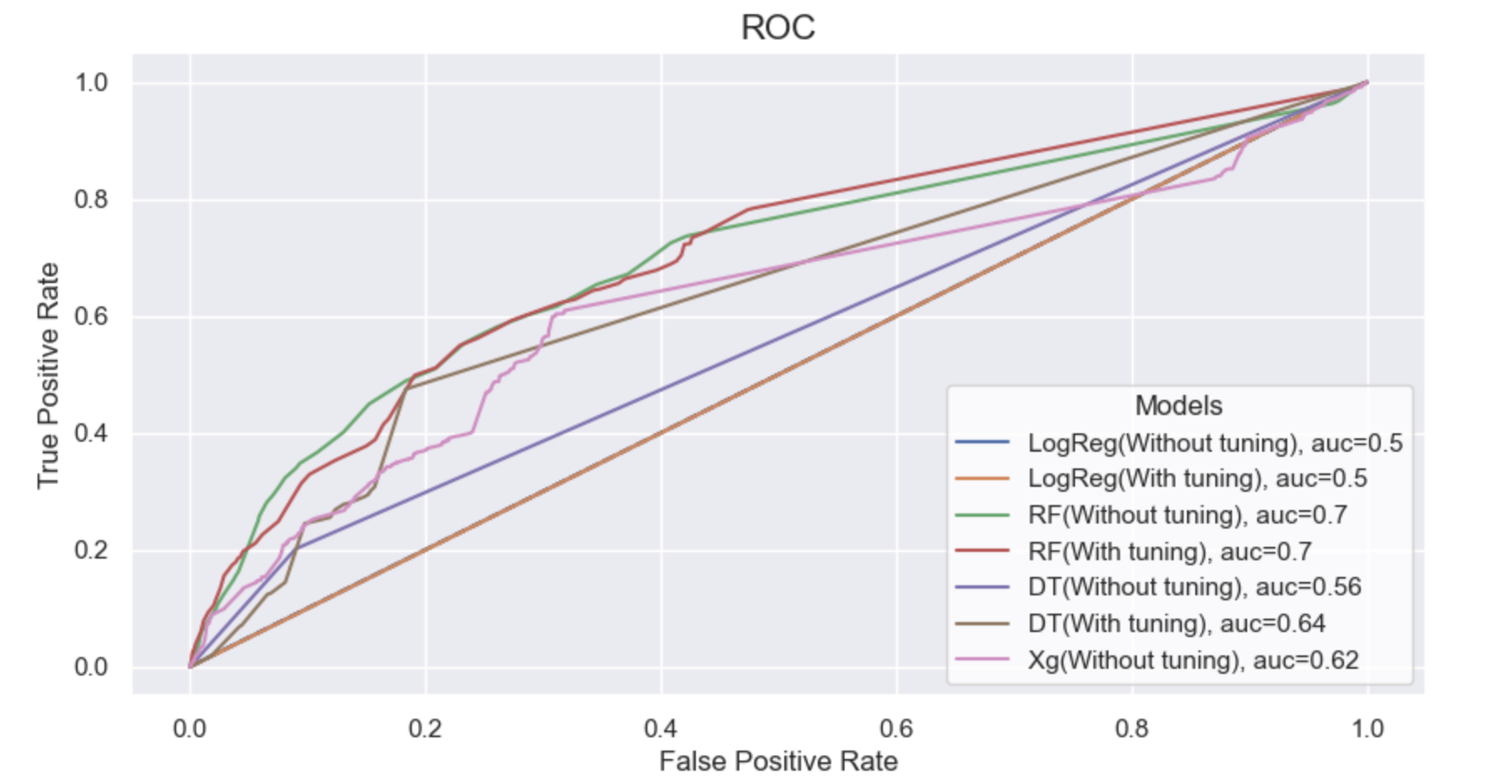
Model Comparison (Roc Curve)
ScreenShot Taken while Evaluation Process.

Slide 19
Project Details
Dataset
Overview
Conclusion
Credit
Card
Default
Prediction
Model
comparison
EDA
Predictive
Modeling

Slide 20
Conclusion
We looked into the data, looking for data imbalance, visualizing the features, and determining how the various aspects related to one another. To determine if the model was successful in predicting the goal value, which is determining whether a credit card customer will default the next month, we utilized both train-validation split and cross-validation. Next, we looked into five forecasting models: We began by using Logistic Regression, Decision Tree, Random Forest, and Xgbosst the accuracy of the Voting classifier is nearly same. Random Forest has the best precision and recall balance. Higher recall can be achieved if low precision is acceptable. Model can be served as an aid to human decision.

Slide 21
Thank | You!

